Slide 1


Git & GitHub Workshop
A Small Introduction
IEEE Student Branch
University of Thessaly
Nikolas Kostakis

Slide 2








Slide 3

Git

Slide 4
What is Git?
Git is a distributed version-control system for tracking changes in source code during software development.
It is designed for coordinating work among programmers, but it can be used to track changes in any set of files.
Its goals include speed, data integrity, and support for distributed, non-linear workflows.

Slide 5

Why should I care about it?
You can keep track of changes in your file/project.
That means no more last.c, lastlast.c, truelast.c etc
You can have different workflows on the same project, without worrying about collateral damage (up to a certain point of course)
More on that later…
It was created by Linus Torvalds! ☺

Slide 6
How it works then?
First, you start by initializing the repository.
Repository is the word used to describe your project & all the complementary files git adds.
Start your project.
After a while, stage you project.

Slide 7


How it works then?
First, you start by initializing the repository.
Repository is the word used to describe your project & all the complementary files git adds.
Start your project.
After a while, stage you project.

Slide 8
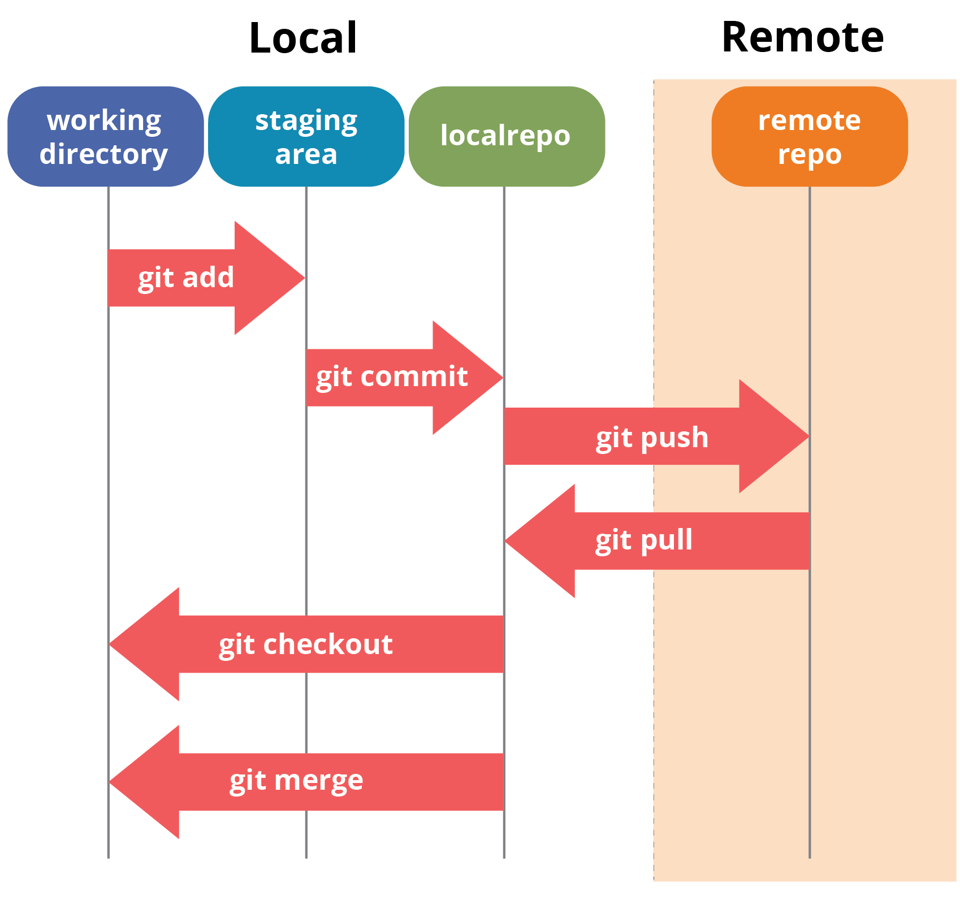
How git staging/saving works:

Slide 9
How it works (again ☺)
First, you start by initializing the repository. (Initial Step)
Start your project.
Stage you project. (Whenever)
Commit the staged file(s) to the local repository. (Whenever)
Push your commit to the remote repository. (Whenever)

Slide 10
Nice, but is that all?
Not at all! In fact, git has more features that make it more robust (but we will not see them in the workshop):
Tags
Mark specific commits with a label to identify/find/promote it.
Submodules
Use different git repositories/projects as part of your project.
Branches

Slide 11
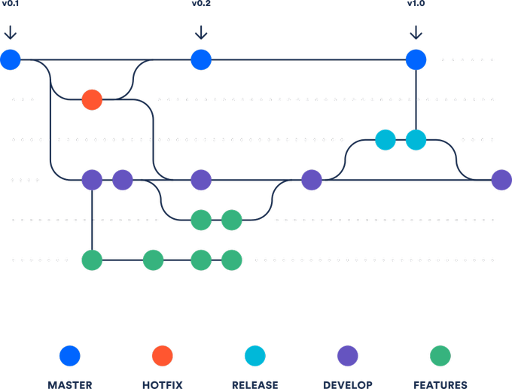
Branches

Slide 12

GitHub

Slide 13
What is GitHub
GitHub is a code hosting platform for version control and collaboration. It lets you and others work together on projects from anywhere.
It supports remote repositories, which are either public or private, and for those it supports wikis, custom webpages, issue tracking etc.
GitHub is the largest code hosting platform.

Slide 14
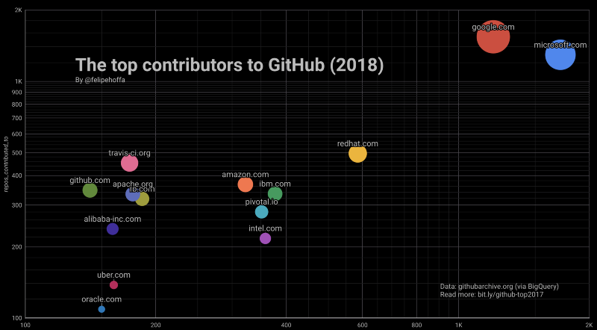

Slide 15


Are there any other code hosting platforms?

Slide 16

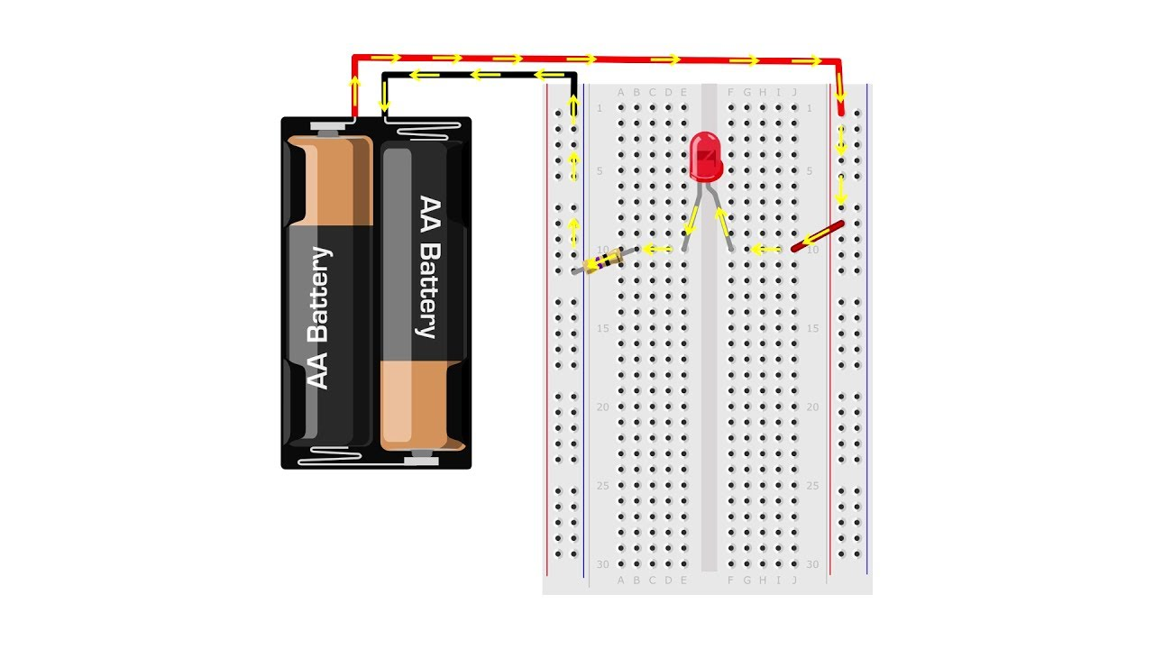


Workshop

Slide 17

Install Git

Slide 18
Install Git
You can easily install Git in all major Operating Systems:
Linux
Windows
Mac

Slide 19

Install Git on Linux
To install git on Linux, open a terminal and write the following command:
sudo <your_package_manager> install git
Your package manager is different based on your distro:
apt or apt-get for Ubuntu
yum for Fedora
packman for Arch Linux
etc.

Slide 20

Install Git on Mac
To install git on macOS, there are two routs to follow:
Open a terminal and type:
git –-version and follow the instructions
Go to the following link and download the installer:
https://git-scm.com/download/mac

Slide 21

Install Git on Windows
To install git on Windows, go to the following link:
https://git-scm.com/download/win
If you have enabled the Developer Tools, you can install a Linux terminal and follow the corresponding step.

Slide 22

Let’s dig into it!
Not literally…

Slide 23
Step 0: Configuration

Slide 24

Step 0: Configuration
Linux / Mac
Windows
Open a terminal.
Right-click in an empty space.
Click on the option:
Git Bash Here

Slide 25
Step 0: Configuration
Write the following command on the terminal:
git config --global user.name “Your name“
The name must be written the same way as it is on GitHub.

Slide 26
Step 0: Configuration
Write the following command on the terminal:
git config --global user.email “Your name“
The email must be the same you used is on GitHub.

Slide 27
Step 1: Initialization

Slide 28
Step 1: Initialization
Create a folder with the name:
My_first_git_repo

Slide 29
Step 1: Initialization
Linux / Mac
Windows
Open a terminal, go to the new folder and type the following command:
git init
Right-click in an empty space.
Click on the option:
Git GUI Here

Slide 30
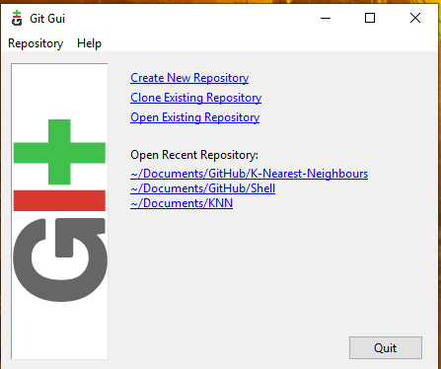
Step 1: Initialization
Linux / Mac
Windows
Open a terminal, go to the new folder and type the following command:
git init
Click on the option:
Create New Repository

Slide 31
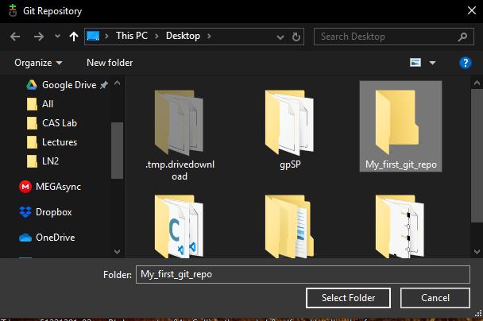
Step 1: Initialization
Linux / Mac
Windows
Open a terminal, go to the new folder and type the following command:
git init
Use the navigator to find the folder.

Slide 32
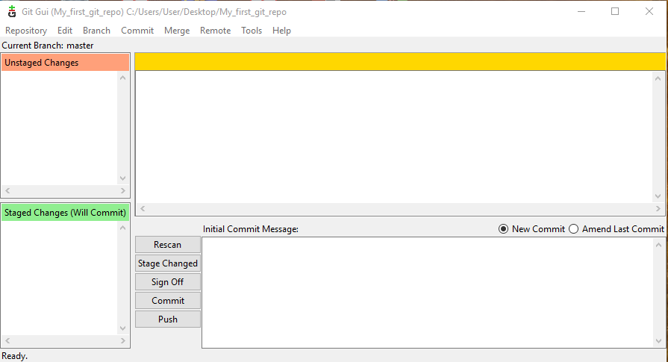
Step 1: Initialization
Linux / Mac
Windows
Open a terminal, go to the new folder and type the following command:
git init

Slide 33
Step 2: Your project
A Mockup on this occasion… ☺

Slide 34
Step 2: Your project
Create a text file with name:
git_test.txt

Slide 35
Step 2: Your project
Inside write the following sentence:
Hi, my name is <your_name>!

Slide 36
Step 3: Staging

Slide 37

Step 3: Staging
Linux / Mac
Windows
Type the following command on the terminal:
git status
On the Git GUI, click the button:
Rescan

Slide 38
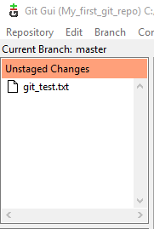
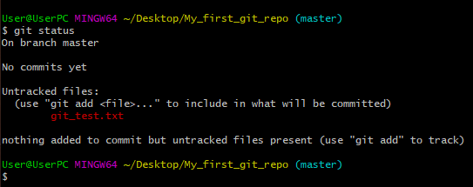
Step 3: Staging
Linux / Mac
Windows

Slide 39
Step 3: Staging
Linux / Mac
Windows
Type the following command on the terminal:
git add -A
On the Git GUI, click the button:
Stage Changed

Slide 40
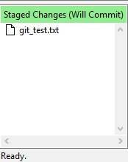
Step 3: Staging
Linux / Mac
Windows
Type the following command on the terminal:
git status

Slide 41
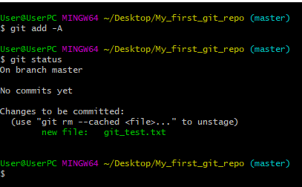
Step 3: Staging
Linux / Mac
Windows

Slide 42
Step 4: Commit

Slide 43
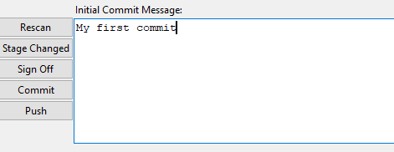
Step 4: Commit
Linux / Mac
Windows
Type the following command on the terminal:
git commit –m “My first commit”
On the Git GUI, click on the text area and write:
My first commit

Slide 44
Step 4: Commit
Linux / Mac
Windows
Type the following command on the terminal:
git commit –m “My first commit”
Click the button:
Commit

Slide 45
Step 5: Remote Repo / GitHub

Slide 46
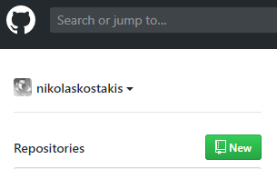
Step 5: Remote Repo / GitHub
Go to github.com, login and click on the New. button

Slide 47
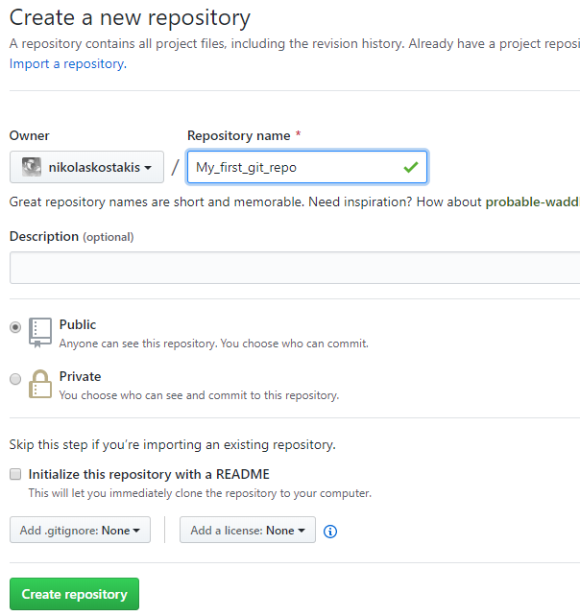
Name the repository: My_first_git_repo & click Create repository

Slide 48
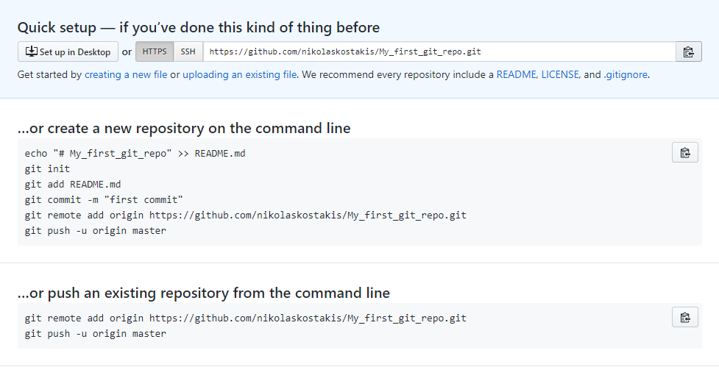

Slide 49
Windows Only Users
Because this step is more complex for the purposes of this workshop, the Windows user will have to follow the next steps on the terminal.

Slide 50
Windows Only Users
Right-click inside the folder were you have the git repository.
Click on the option:
Git Bash Here

Slide 51
Step 5: Remote Repo / GitHub
Write the following command on the terminal:
git remote add origin https://github.com/<your_usern ame>/My_first_git_repo.git

Slide 52
Step 5: Remote Repo / GitHub
Write the following command on the terminal:
git push origin master
Your credentials for GitHub will be required.

Slide 53
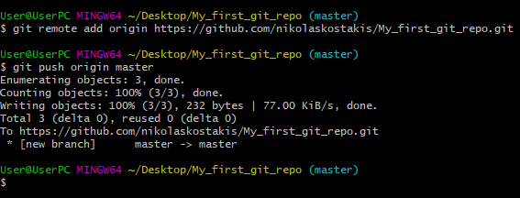

Slide 54
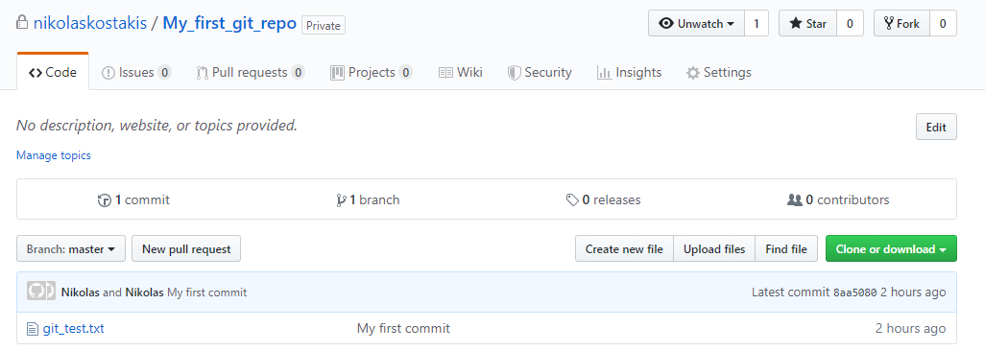

Slide 55

Any questions?

Slide 56
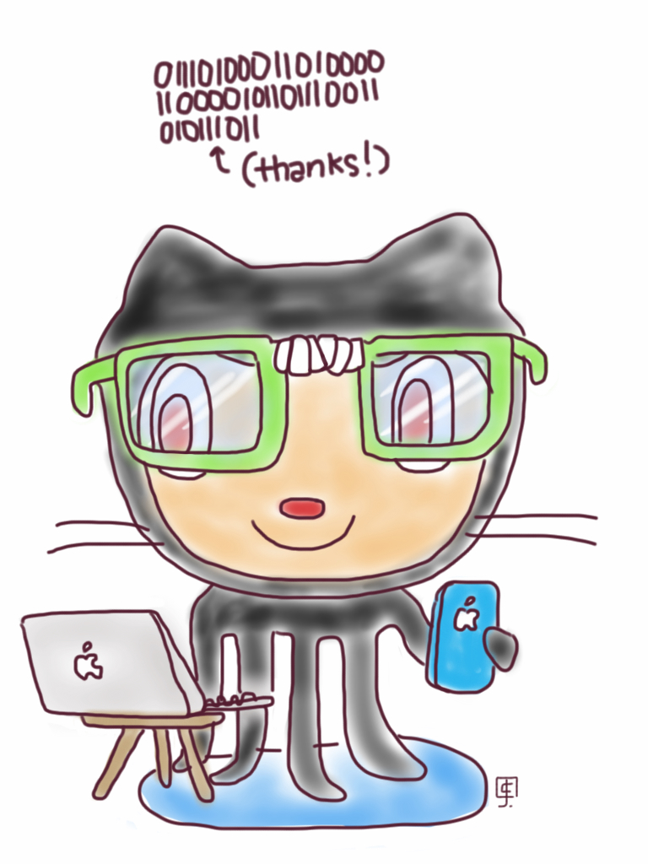
Thank you for your time!

